Slide 1
80386

Slide 2
References
  Hall
  Rafiq
  Brey
Hall / Rafiq presents a concise treatment
the materials are scattered throughout the book in different chapters

Slide 3
Limitations of 286
16-bit ALU
64K segment size
cannot be easily switched back and forth between real and protected mode
  to come back to the real mode from protected mode, you have to switched off the 286

Slide 4
386 was designed to overcome these limitations
32 bit ALU
segment size can be as large as 4G
  a program can have as many as 16K segments.
  So, a program has access to 4Gx16K=64TB of virtual memory
386 has a virtual 86 mode which allows easy switching between real and protected modes.

Slide 5
80386 Features
Alternatively referred to as a 386 or the i386
Intel introduced the first 32-bit chip, 80386, in October 1985 as an upgrade to the 80286 processor
Intel stopped producing 386 since September 2007.
386 incorporates 275,000 transistor
386 was capable of performing more than five million instructions every second (MIPS)
386 was available in clock speeds between 12 and 40MHz.

Slide 6
versions of 386
Two versions were commonly available:
      1) 80386DX
      2) 80386SX
The original 386 processor was renamed as 80386DX or 386DX after introducing 386SX
80386SX was introduced in 1988 as a low cost alternative to the original 386.

Slide 7
versions of 386...
80386SX was developed after the DX for application that didn’t require the full 32-bit capabilities.
It is found that many PCs use the same basic mother board design as the 80286.
Most application need less than the 16MB of memory, so the SX is popular and less costly version of the 80386 microprocessor.

Slide 8
versions of 386...
The 80386SX lacked a math coprocessor but still featured the 32-bit architecture and built-in multitasking.
The chip was available in clock speeds of 16MHz, 20MHz, 25MHz, and 33MHz.

Slide 9
versions of 386...
The 80386SL, more commonly known as the 386SL, was a version of 386DX first manufactured in 1990
  featuring low power consumption and
  was used mainly in portable computers.

Slide 10
DX vs SX
80386DX | 80386SX
32 bit address bus 32 bit data bus | 24 bit address bus 16 bit data bus
Packaged in 132 pin PGA | 100 pin flat package
Address 4GB of memory | 16 MB of memory
Both have the same internal architecture.
Lower cost package and the ease of interfacing to 8-bit and 16-bit memory and peripherals make SX suitable for use in low cost systems.

Slide 11
80386
Internal Architecture

Slide 12
EU
EU
AU
8085
BIU
IU
BIU
8086
80286
EU
SU
MMU
PU
AU
IU
DU
BIU
PrefU
80386

Slide 13
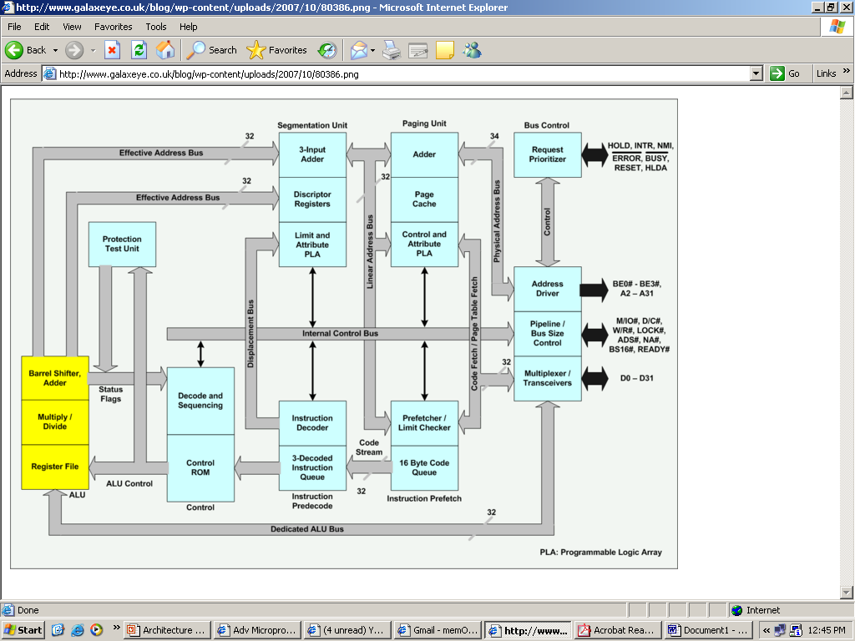

Slide 14
Architecture of 80386
The Internal Architecture of 80386 is divided into 3 sections:
  i) Central processing unit (CPU) which is further divided into
    Execution unit (EU) and
    Instruction unit (IU)
  ii) Memory management unit (MMU) consists of
    Segmentation unit and
    Paging unit.
  iii) Bus interface unit( BIU)

Slide 15
Architecture of 80386...
Execution unit
Execution unit has 8 General purpose registers which are either used for handling data or calculating offset addresses.

Slide 16
•The 80386 has eight 32-bit general purpose registers which may be used as either 8 bit, 16 bit or 32 bit registers.
•A 32-bit register known as an extended register, is represented by the register name with prefix E.
  •Example : A 32 bit register corresponding to AX is EAX
•So the general purpose registers of 386 are
  EAX, EBX, ECX, EDX, EBP, ESP, ESI and EDI

Slide 17
• BP, SP, SI, DI represents the lower 16 bit of their 32 bit counterparts, and can be used as independent 16 bit registers.
•The 16 bit flag register is available along with 32 bit counterpart EFLAGS.

Slide 18
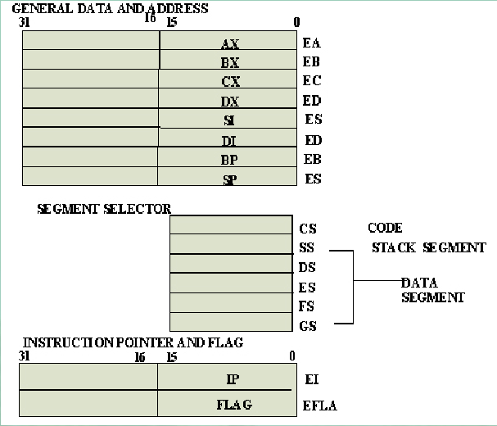
EAX
EBX
ECX
EDX
ESI
EDI
EBP
ESP
EFLAGS

Slide 19
Flag Register
The Flag register of 80386 is a 32 bit register.
Out of the 32 bits, Intel has reserved bits D18 to D31, D5 and D3 and set to 0
while D1 is always set at 1.
Two extra new flags are added to the 80286 flag to derive the flag register of 80386.
They are VM and RF flags.

Slide 20
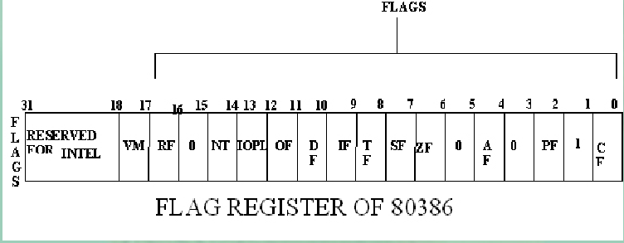
Flag Register...
Old flags of 286
New flags for 386

Slide 21
VM - Virtual Mode Flag
If this flag is set to 1, the 80386 enters the virtual 8086 mode within the protection mode.
When VM bit is 0, 386 operates in protected mode
This is to be set only when the 80386 is in protected mode.
This bit can be set using IRET instruction or any task switch operation only in the protected mode.

Slide 22
RF- Resume Flag
If RF=1, 386 ignores debug faults
  does not take another exception so that an instruction can be restarted after a normal debug exception.
If RF=0, 386 takes another debug exception to service debug faults

Slide 23
RF- Resume Flag...
This flag is used with the debug register breakpoints.
It is checked at the starting of every instruction cycle and if it is set, any debug fault is ignored during the instruction cycle.
The RF is automatically reset after successful execution of every instruction, except for IRET and POPF instructions.

Slide 24
RF- Resume Flag...
Also, it is not automatically cleared after the successful execution of JMP, CALL and INT instruction causing a task switch.
These instruction are used to set the RF to the value specified by the memory data available at the stack.

Slide 25
Architecture of 80386...
Instruction unit
The Instruction unit decodes the op-code bytes received from the 16-byte instruction code queue and arranges them in a 3-instruction decoded instruction queue.
After decoding them pass it to the control section for deriving the necessary control signals.

Slide 26
Architecture of 80386...
Instruction unit
The barrel shifter increases the speed of all shift and rotate operations.
The multiply / divide logic implements the bit-shift-rotate algorithms to complete the operations in minimum time.
Even 32- bit multiplications can be executed within one microsecond by the multiply / divide logic.

Slide 27
Architecture of 80386...
Segmentation unit
Segmentation unit allows the use of two address components, viz. segment and offset for relocate ability and sharing of code and data.
Segmentation unit allows segments of size 4GB at max.
The Segmentation unit provides a 4 level protection mechanism for protecting and isolating the system code and data from those of the application program.

Slide 28
Besides 4 segment registers of 286, 386 has 2 more segment registers
The six segment registers available in 80386 are CS, SS, DS, ES, FS and GS.
•The CS and SS are the code and the stack segment registers respectively, while DS, ES,FS, GS are 4 data segment registers.
•A 16 bit instruction pointer IP is available along with 32 bit counterpart EIP.

Slide 29
EIP

Slide 30
Architecture of 80386...
Paging unit
The Paging unit organizes the physical memory in terms of pages of 4kbytes size each.
Paging unit works under the control of the segmentation unit, i.e. each segment is further divided into pages.
The virtual memory is also organizes in terms of segments and pages by the memory management unit.
Paging unit converts linear addresses into physical addresses.

Slide 31
Architecture of 80386...
Paging unit
The control and attribute PLA checks the privileges at the page level.
Each of the pages maintains the paging information of the task.
The limit and attribute PLA checks segment limits and attributes at segment level to avoid invalid accesses to code and data in the memory segments.

Slide 32
Architecture of 80386...
Bus control unit
The Bus control unit has a prioritizer to resolve the priority of the various bus requests.
This controls the access of the bus.
The address driver drives the bus enable and address signal A2 – A31.
The pipeline and dynamic bus sizing unit handle the related control signals.
The data buffers interface the internal data bus with the system bus.

Slide 33
Hidden Registers/
Program invisible registers/
Special Registers

Slide 34
Segment Descriptor Registers
The six segment registers (CS, DS, ES, FS, GS & SS) have corresponding six 73 bit descriptor registers.
Each of them contains 32 bit base address, 32 bit base limit and 9 bit attributes.
These are automatically loaded when the corresponding segments are loaded with selectors.

Slide 35
Control Registers
The 80386 has four 32 bit control registers CR0, CR1, CR2 and CR3 to hold global machine status independent of the executed task.
CR1 is not used in 386. It is reserved for future use.
Load and store instructions are available to access these registers.

Slide 36
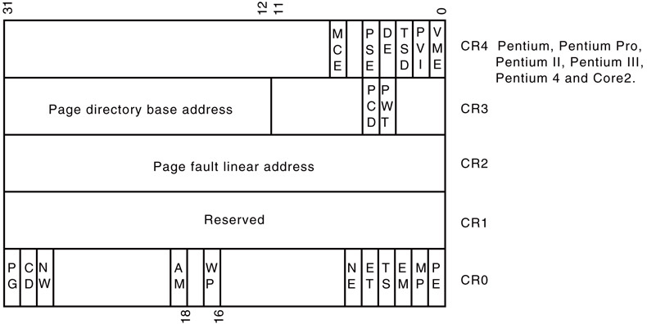
386 control registers
31
0

Slide 37
System Address Registers
The 386 supports four types of descriptor table:
  global descriptor table (GDT),
  local descriptor table (LDT),
  interrupt descriptor table (IDT), and
  task state segment descriptor (TSS).
Four special registers are defined to hold the base address of these tables
  global descriptor table Register (GDTR),
  local descriptor table Register (LDTR),
  interrupt descriptor table Register (IDTR), and
  task state segment descriptor Register (TR).

Slide 38
Debug Registers
Intel has provide a set of 8 debug registers for hardware debugging. Out of these eight registers DR0 to DR7, two registers DR4 and DR5 are Intel reserved.
The initial four registers DR0 to DR3 store four program controllable breakpoint addresses, while DR6 and DR7 respectively hold breakpoint status and breakpoint control information.

Slide 39
Debug Registers
breakpoint control info
DR7
breakpoint status
DR6
RESERVED
DR5
RESERVED
DR4
Linear breakpoint address 3
DR3
Linear breakpoint address 2
DR2
Linear breakpoint address 1
DR1
Linear breakpoint address 0
DR0
31
0

Slide 40
Test Registers
Two test register are provided by 80386 for page caching namely test control and test status register.

Slide 41
386 Signals
[Hall & Rafiq]

Slide 42
80386
Address Bus
D₀-D₃₁
Data Bus
A₂-A₃₁
Byte Enables
BE₀-BE₃
ADS
W/R
BS16
D/C
M/IO
Bus Cycle Definition
BUS Control
NA
LOCK
READY
PEREQ
HOLD
BUSY
Co-processor Signaling
BUS Arbitration
HOLDA
ERROR
INTR
VCC
Power Connection
NMI
GND
RESET
2x Clock
CLK2

Slide 43
Signals...Address Bus
Address bus consists of A2 to A31 address lines and BE0 to BE3 byte/bank enable lines
No A0 & A1 address lines are available in 386
  they are internally decoded to produce BE0 to BE3 signals
Memory are arranged in 4 Banks
BE0-BE3 allow 386 to transfer byte, word and double word

Slide 44
Signals... (I/O Ports)
386 direct port structure is an extension of 286 port structure to include 32-bit ports
32-bit I/O ports can be constructed by connecting 8-bit I/O port devices --- such as 8255 --- in parallel

Slide 45
Signals... (I/O Ports)
386 IN or OUT instruction followed by 8-bit port address can be used to address 256 8-bit port or 128 16-bit port or 64 32-bit ports.
Using DX register to hold port address 386 can address 64K 8-bit port,32K 16-bit port or 16K 32-bit ports
I/O port addresses 00F8H through 00FFH are reserved by Intel
Co-processors are at 800000F8H through 800000FFH.

Slide 46
Signals...Bus control
ADS : ADDRESS STATUS indicates that a valid bus cycle definition and address
BS16 : BUS SIZE 16 input allows direct connection of 32-bit and 16-bit data buses
NA : NEXT ADDRESS is used to request address pipelining by an external hardware

Slide 47
Signals...Co-processor Signaling
PEREQ : PROCESSOR EXTENSION REQUEST indicates that the processor extension has data to be transferred by the 386 DX
BUSY : indicates that co-processor is still busy probably still executing the previous instruction
ERROR : signals an error condition from a processor extension

Slide 48
Signals...Clock
CLK2 : provides the basic timing for 386.
applied clock is internally divided by 2 to produce clock signals which actually drives 386 operations
  for 33 MHz operation then, a 66 MHz clock is applied to CLK2

Slide 49
BIST
386 contains a large amount of built-in self test (BIST) circuitry
if BUSY is held low, while RESET is held low, 386 automatically enters into BIST
In 2²⁰ CLK2 cycles it can test about 60% of its internal circuitry
if 386 passes all tests, a signature of all 0’s will be put in EAX register

Slide 50
Memory Organization
Memory is organized in 4 banks

Slide 51
ADDRESSING MODES

Slide 52
ADDRESSING MODES
Same as 286 with one new mode
  scale indexed addressing mode
  scaled index mode is efficient for accessing arrays or structures
The 80386 supports overall eleven addressing modes to facilitate efficient execution of higher level language programs.
In case of all those modes, the 80386 can now have 32-bit immediate or 32- bit register operands or displacements.

Slide 53
ADDRESSING MODES
The 80386 has a family of scaled modes.
In case of scaled modes, any of the index register values can be multiplied by a valid scale factor to obtain the displacement.
The valid scale factor are 1, 2, 4 and 8.
The different scaled modes are as follows.

Slide 54
ADDRESSING MODES... different scaled modes
Scaled Indexed Mode: Contents of an index register are multiplied by a scale factor that may be added further to get the operand offset.
Based Scaled Indexed Mode: Contents of the an index register are multiplied by a scale factor and then added to base register to obtain the offset.
      MOV AX, [EDI+2*ECX]

Slide 55
ADDRESSING MODES... different scaled modes
Based Scaled Indexed Mode with Displacement: The Contents of the an index register are multiplied by a scaling factor and the result is added to a base register and a displacement to get the offset of an operand.
MOV [EAX+2*EDI+100H], CX

Slide 56
386 modes of operation

Slide 57
386 modes of operation
There are 3 modes of operations:
  Real mode
    we have already discussed it
  Protected mode
    we have already discussed it --- same as 286. Only difference is in descriptor description
  virtual 8086 mode

Slide 58
Real Address Mode of 80386
After reset, the 80386 starts from memory location FFFFFFF0H under the real address mode.
In the real mode, 80386 works as a fast 8086 with 32-bit registers and data types.
In real mode, the default operand size is 16 bit but 32- bit operands and addressing modes may be used with the help of override prefixes.
The segment size in real mode is 64k, hence the 32-bit effective addressing must be less than 0000FFFFFH.
The real mode initializes the 80386 and prepares it for protected mode.

Slide 59
Real Address Mode of 80386...
In the real mode, the 80386 can address at the most 1Mbytes of physical memory using address lines A0-A19.
Paging unit is disabled in real addressing mode, and hence the real addresses are the same as the physical addresses.
To form a physical memory address, appropriate segment registers contents (16-bits) are shifted left by four positions and then added to the 16-bit offset address

Slide 60
Real Address Mode of 80386...
The segment in 80386 real mode can be read, write or executed, i.e. no protection is available.
Any fetch or access past the end of the segment limit generate exception 13 in real address mode.
The segments in 80386 real mode may be overlapped or non-overlapped.
The interrupt vector table of 80386 has been allocated 1Kbyte space starting from 00000H to 003FFH.

Slide 61
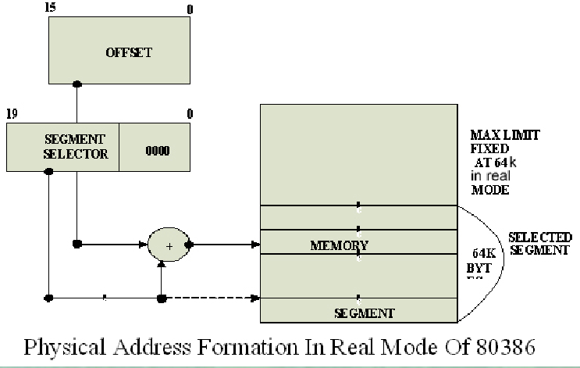

Slide 62
Protected Mode of 80386

Slide 63
Protected mode
same as 286
Only difference is in
  descriptor description
  optional use of page
if the paging unit is disabled, then linear address produced by segment unit is used as physical address
otherwise the paging unit converts the linear address into page address.
The paging mechanism allows handling of large segments of memory in terms of pages of 4Kbyte size.

Slide 64
Protected Mode of 80386
All the capabilities of 80386 are available for utilization in its protected mode of operation.
The 80386 in protected mode support all the software written for 80286 and 8086 to be executed under the control of memory management and protection abilities of 80386.
The protected mode allows the use of additional instruction, addressing modes and capabilities of 80386.

Slide 65
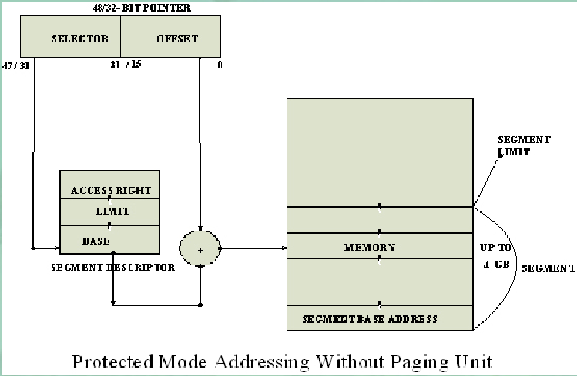

Slide 66
ADDRESSING IN PROTECTED MODE
In this mode, the contents of segment registers are used as selectors to address descriptors which contain the segment limit, base address and access rights byte of the segment.
The effective address (offset) is added with segment base address to calculate linear address.
This linear address is further used as physical address, if the paging unit is disabled, otherwise the paging unit converts the linear address into physical address.

Slide 67
ADDRESSING IN PROTECTED MODE
The paging unit is a memory management unit enabled only in protected mode.
The paging mechanism allows handling of large segments of memory in terms of pages of 4Kbyte size.
The paging unit operates under the control of segmentation unit.
The paging unit if enabled converts linear addresses into physical address, in protected mode.

Slide 68
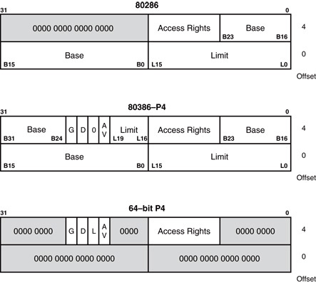
Descriptor

Slide 69
Granularity (G) bit
when this bit is cleared (G = 0) the 20-bit limit field is assumed to be measured in units of 1byte.
If it is set (G = 1), the limit field is in units of 4KB

Slide 70
Default size (D)-bit
when this bit is cleared, D = 0, operands contained within this segment are assumed to be 16 bits in size.
When it is set, D = 1, operands are assumed to be 32-bits.

Slide 71
Example of D bit uses
for Code segment
  D = 0 means 16-bit 80286 code
  D = 1 means 32-bit 80386+ code
for Stack Segment
  D = 0 ✓ stack operations are 16-bit wide,
        SP is used as a stack pointer,
        maximum stack size is FFFF (64 KB)
  D = 1 ✓ stack operations are 32-bit wide,
        ESP is used as a stack pointer,
        maximum stack size is FFFFFFFF (4GB)

Slide 72
Available (Av) bit
The AVL (available) field specifies whether the descriptor is available for user or it is for use by operating system
Av=0 not available for user, used by OS
Av=1 available for user

Slide 73
•The 80386 has five types of descriptors listed as follows:
1.Code or Data Segment Descriptors.
2.System Descriptors.
3.Local descriptors.
4.TSS (Task State Segment) Descriptors.
5.GATE Descriptors.
•The 80386 provides a four level protection mechanism exactly in the same way as the 80286 does.

Slide 74
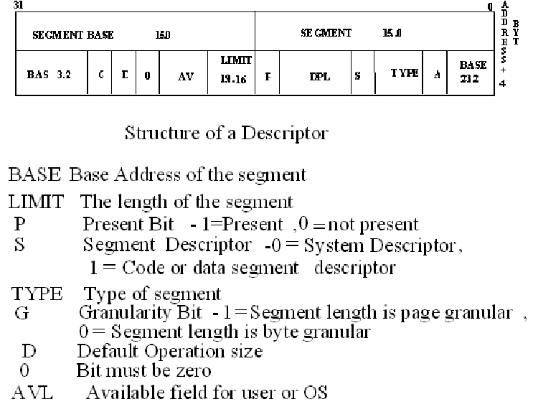

Slide 75
Virtual 86 mode
In its protected mode of operation, 386 provides a virtual 8086 operating environment to execute the 8086 programs.
The real mode can also used to execute the 8086 programs along with the capabilities of 386, like protection and a few additional instructions.
Once the 386 enters the protected mode from the real mode, it cannot return back to the real mode without a reset operation.

Slide 76
Virtual 86 mode...
Thus, the virtual 8086 mode of operation of 386, offers an advantage of executing 8086 programs while in protected mode.
The address forming mechanism in virtual 8086 mode is exactly identical with that of 8086 real mode.
In virtual mode, 8086 can address 1Mbytes of physical memory that may be anywhere in the 4Gbytes address space of the protected mode of 386.

Slide 77
Virtual 86 mode...
Like 386 real mode, the addresses in virtual 8086 mode lie within 1Mbytes of memory.
In virtual mode, the paging mechanism and protection capabilities are available at the service of the programmers.
The 386 supports multiprogramming, hence more than one programmer may be use the CPU at a time.

Slide 78
Paging

Slide 79
Why Paging ?
The protected mode segmentation and virtual memory scheme of 286 and 386 are essentially the same
Only difference is 386 segment can be as large as 4G, instead of 64K as in 286
swapping in and out of 4G to and from physical memory requires too long time
so paging mechanism was developed
swapping 4K pages is faster

Slide 80
How Paging mechanism works?
4G memory is divided into 1M pages of 4K
The starting addresses of these 1M pages are kept in two-level tables
First level table, known as Page Directory, contains 1K entries for the second level table, known as Page Tables
Each Page Table contains the starting addresses of 1K pages

Slide 81
How Paging mechanism works?...
Page Directory
There is only one Page Directory in the system
Starting address of Page Directory is in CR3
The paging unit is controlled by the contents
of the microprocessor’s control registers.
386 has 4 control registers CR0 through CR3.
CR1 of 386 are kept reserved by Intel

Slide 82
MEMORY PAGING
The memory paging mechanism allows any physical memory location to be assigned to any linear address.
Linear address is defined as the address generated by a program.
Physical address is the actual memory location accessed by a program.
With memory paging, the linear address is invisibly translated to any physical address.

Slide 83
Paging Registers
The paging unit is controlled by the contents
of the microprocessor’s control registers.
386 has 4 control registers CR0 through CR3.
CR1 of 386 are kept reserved by Intel

Slide 84
386 control registers

Slide 85
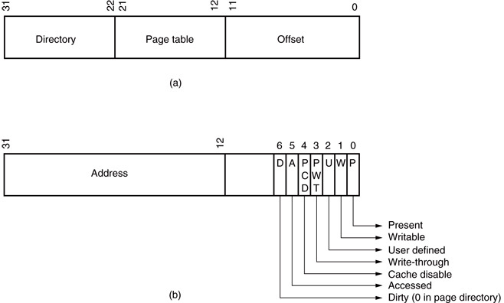
How Paging mechanism works?...
The 32-bit linear address, as generated by software, is broken into three sections that are used to access the operand in the memory

Slide 86
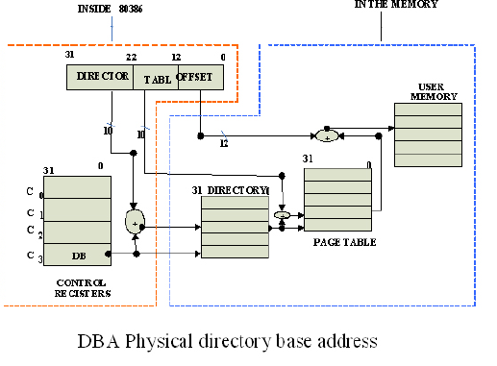
The paging mechanism of 386

Slide 87
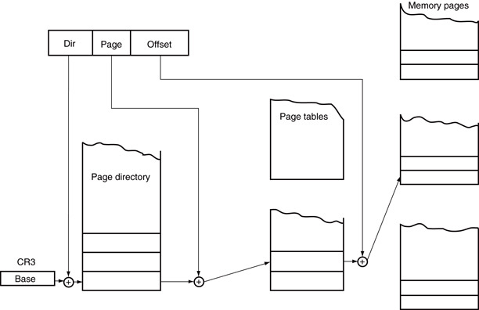
The paging mechanism of 386

Slide 88
Page Directory or Page Table entry
Higher order 20 bit of addresses of Page Table or Page. It’s implied that the lower order 12 bit is 0. This 12 bit is used to keep other info of the entry

Slide 89
P bit
The P bit of the entries indicate, whether the entry (page table/page) is present in the memory
  If P=1, the entry is in the memory
  If P=0, the entry is not in the memory
The P bit of the currently executed page is always high.

Slide 90
R/W and U/S bits
The read/write (R/W) bit allows a page to be marked as read only or read/write
U/S bit is used to specify one of two privilege levels, user or supervisor
  0 specifies an user level or lowest level of privilege
  1 specifies a supervisor level or higher level (level 0,1, and 2) privilege
User/Supervisor (U/S) and R/W bits can be used in place of or in addition to the protection mechanism.

Slide 91
D and A bits
The D bit (Dirty bit) is set before a write operation to the page is carried out.
  The D-bit is undefined for page directory entries.
The accessed bit A is set by 80386 before any access to the page.
The OS can periodically check and reset this bit to determine how often the page is being used

Slide 92
The User / Supervisor (U/S) bit and read/write bit are used to provide protection. These bits are decoded to provide protection under the 4 level protection model.
•The level 0 is supposed to have the highest privilege, while the level 3 is supposed to have the least privilege.
•This protection provide by the paging unit is transparent to the segmentation unit.

Slide 93
Translation Look-aside Buffer (TLB)
As said before, Page Directory and Page Tables are located in memory
To avoid having to read memory twice in order to get access to required memory operand, 386 maintains a special cache called TLB
TLB is a four-way set-associative cache that holds the page addresses of 32 most recently used pages

Slide 94
Cache memory [Hall/360-363]
Direct mapped
Associative
  two-way
  four-way
  fully

Slide 95
Translation Look-aside Buffer (TLB)
Intel has incorporated a special type of cache called TLB (translation look-aside buffer).
  because repaging a 4K-byte section of memory requires access to the page directory and a page table, both located in memory

Slide 96
Overhead for paging
Directory Table occupies 4KB
  1K entry X 4 bytes per entry = 4KB
Page Tables occupy 4MB
  1M page entry X 4 bytes per entry = 4MB
This represents a considerable amounts of memory

Slide 97
The Page Directory and Page Table
Only one page directory in the system.
The page directory contains 1024 double word addresses that locate up to 1024 page tables.
Page directory and each page table are 4K bytes in length.

Slide 98
DOS and EMM386.EXE use page tables to redefine memory between locations C8000H–EFFFFH as upper memory blocks.
  done by repaging extended memory to backfill conventional memory system to allow DOS access to additional memory
Each entry in the page directory corresponds to 4M bytes of physical memory.
Each entry in the page table repages 4K bytes of physical memory.
Windows also repages the memory system.

Slide 99
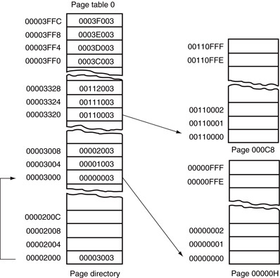
Figure 2–14 The page directory, page table 0, and two memory pages. Note how the address of page 000C8000–000C9000 has been moved to 00110000–00110FFF.

Slide 100
Paging Operation
Paging is one of the memory management techniques used for virtual memory multitasking operating system.
The segmentation scheme may divide the physical memory into a variable size segments but the paging divides the memory into a fixed size pages.
The segments are supposed to be the logical segments of the program, but the pages do not have any logical relation with the program.
The pages are just fixed size portions of the program module or data.

Slide 101
Paging Operation...
The advantage of paging scheme is that the complete segment of a task need not be in the physical memory at any time.
Only a few pages of the segments, which are required currently for the execution need to be available in the physical memory. Thus the memory requirement of the task is substantially reduced, relinquishing the available memory for other tasks.
Whenever the other pages of task are required for execution, they may be fetched from the secondary storage.
The previous page which are executed, need not be available in the memory, and hence the space occupied by them may be relinquished for other tasks.
Thus paging mechanism provides an effective technique to manage the physical memory for multitasking systems.

Slide 102
Paging Unit
The paging unit of 80386 uses a two level table mechanism to convert a linear address provided by segmentation unit into physical addresses.
The paging unit converts the complete map of a task into pages, each of size 4K. The task is further handled in terms of its page, rather than segments.
The paging unit handles every task in terms of three components namely page directory, page tables and page itself.

Slide 103
Paging Descriptor Base Register: The control register CR2 is used to store the 32-bit linear address at which the previous page fault was detected.
The CR3 is used as page directory physical base address register, to store the physical starting address of the page directory.
The lower 12 bit of the CR3 are always zero to ensure the page size aligned directory. A move operation to CR3 automatically loads the page table entry caches and a task switch operation, to load CR0 suitably.

Slide 104
Page Directory : This is at the most 4Kbytes in size. Each directory entry is of 4 bytes,thus a total of 1024 entries are allowed in a directory.The upper 10 bits of the linear address are used as an index to the corresponding page directory entry. The page directory entries point to page tables.
•Page Tables: Each page table is of 4Kbytes in size and many contain a maximum of 1024 entries. The page table entries contain the starting address of the page and the statistical information about the page.
•The upper 20 bit page frame address is combined with the lower 12 bit of the linear address. The address bits A12- A21 are used to select the 1024 page table entries. The page table can be shared between the tasks.

Slide 105
31 12 11 10 9 8 7 6 5 4 3 2 1 0
PAGE TABLE ADDRESS 31..12 | OS RESERVED | 0 | 0 | D | A | 0 | 0 | U S | R W | P
Page Directory Entry
31 12 11 10 9 8 7 6 5 4 3 2 1 0
PAGE FRAME ADDRESS31..12 | OS RESEVED | 0 | 0 | D | A | 0 | 0 | U S | R W | P
Page Table Entry

Slide 106
Instruction Set
Some new instructions are there,
  But we will not study those

Slide 107
Interrupt
Some new interrupts are added in 386
Type 0 to Type 4 --- used in 8086
Type 5 to Type 7 --- introduced during 186
Type 8 to Type 14 --- new in 386

Slide 108
Interrupt …
Type 8 --- Double fault
  activated whenever two separate interrupts occur during the same instruction
Type 9 --- co-processor segment overrun
  Occurs if co-processor op-code memory operand extends beyond offset address
Type 10 --- Invalid task state segment
  Occurs if the TSS is invalid. Mostly this is caused because TSS is not initialized.

Slide 109
Interrupt …
Type 11 --- segment not present
  Occurs when P-bit in a descriptor indicates that the segment is invalid
Type 12 ---stack fault
  Occurs if the stack segment is not present (P=0) or if the limit is exceeded
Type 13 --- general protection fault
  Occurs for protection violation
Type 14 --- page fault
  Occurs for any page fault memory or code access.

